Slide 1
Programming Language II CSE-215
Prof. Dr. Mohammad Abu Yousuf
yousuf@juniv.edu

Slide 2
Exception Handling-1

Slide 3
The exception handling in java is one of the powerful mechanism to handle the runtime errors so that normal flow of the application can be maintained.
What is exception:
Dictionary Meaning: Exception is an abnormal condition.
In java, exception is an event that disrupts the normal flow of the program. It is an object which is thrown at runtime.

Slide 4
Exception-Handling Fundamentals
An exception is an abnormal condition that arises in a code sequence at run time.
In other words, an exception is a runtime error.
A Java exception is an object that describes an exceptional (that is, error) condition that has occurred in a piece of code.
When an exceptional condition arises, an object representing that exception is created and thrown in the method that caused the error.

Slide 5
Exception-Handling Fundamentals
What is exception handling:
Exception Handling is a mechanism to handle runtime errors such as ClassNotFound, IO, SQL, Remote etc.
That method may choose to handle the exception itself, or pass it on.
Either way, at some point, the exception is caught and processed.
Exceptions can be generated by the Java run-time system, or they can be manually generated by your code.

Slide 6
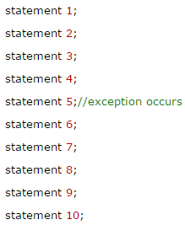
Exception-Handling Fundamentals
Advantage of Exception Handling
The core advantage of exception handling is to maintain the normal flow of the application. Exception normally disrupts the normal flow of the application that is why we use exception handling. Let's take a scenario:
Suppose there is 10 statements in your program and there occurs an exception at statement 5, rest of the code will not be executed i.e. statement 6 to 10 will not run. If we perform exception handling, rest of the statement will be executed. That is why we use exception handling in java.

Slide 7
Exception-Handling Fundamentals
Java exception handling is managed via five keywords: try, catch, throw, throws, and finally.
Program statements that you want to monitor for exceptions are contained within a try block.
If an exception occurs within the try block, it is thrown. Your code can catch this exception (using catch) and handle it in some rational manner.

Slide 8
Exception-Handling Fundamentals
System-generated exceptions are automatically thrown by the Java runtime system. To manually throw an exception, use the keyword throw.
Any exception that is thrown out of a method must be specified as such by a throws clause.
Any code that absolutely must be executed after a try block completes is put in a finally block.

Slide 9
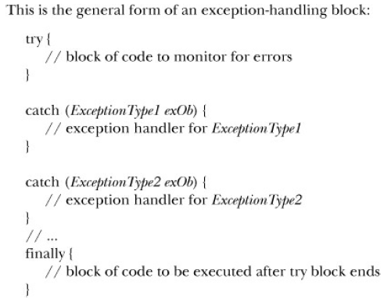
Here, ExceptionType is the type of exception that has occurred.

Slide 10
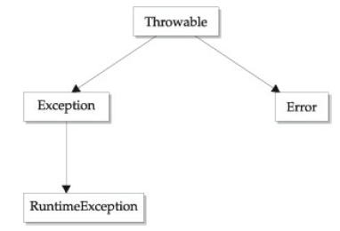
Exception Types
All exception types are subclasses of the built-in class Throwable.

Slide 11
Exception Types
There are mainly two types of exceptions: checked and unchecked where error is considered as unchecked exception. The sun microsystem says there are three types of exceptions:
Checked Exception
Unchecked Exception
Error

Slide 12
Exception Types
1) Checked Exception
The classes that extend Throwable class except RuntimeException and Error are known as checked exceptions e.g.IOException, SQLException etc. Checked exceptions are checked at compile-time.
2) Unchecked Exception
The classes that extend RuntimeException are known as unchecked exceptions e.g. ArithmeticException, NullPointerException, ArrayIndexOutOfBoundsException etc. Unchecked exceptions are not checked at compile-time rather they are checked at runtime.
3) Error
Error is irrecoverable e.g. OutOfMemoryError, VirtualMachineError, AssertionError etc.

Slide 13
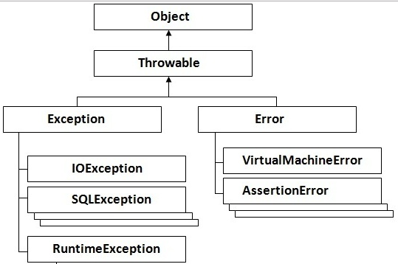
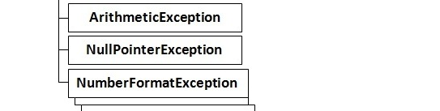
Hierarchy of Java Exception classes

Slide 14
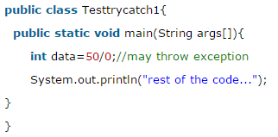
Problem without exception handling
Let's try to understand the problem if we don't use try-catch block:
Output:

Slide 15
Problem without exception handling
As displayed in the above example, rest of the code is not executed (in such case, rest of the code... statement is not printed).
There can be 100 lines of code after exception. So all the code after exception will not be executed.

Slide 16
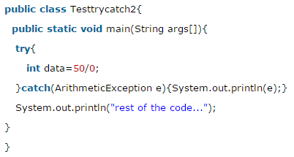
Solution by exception handling of previous problem
Output:
Exception in thread main java.lang.ArithmeticException:/ by zero
rest of the code...
Now, as displayed in the above example, rest of the code is executed i.e. rest of the code... statement is printed.

Slide 17
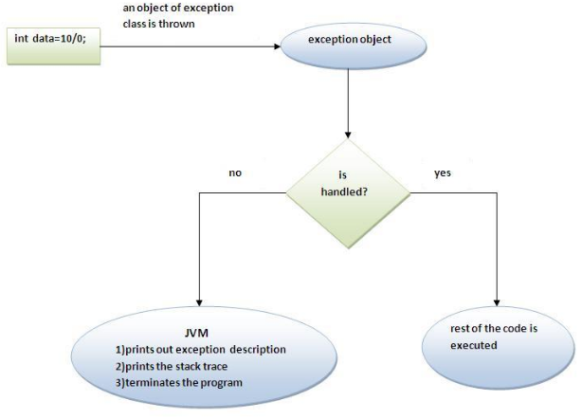
Internal working of java try-catch block

Slide 18
Internal working of java try-catch block
The JVM firstly checks whether the exception is handled or not. If exception is not handled, JVM provides a default exception handler that performs the following tasks:
Prints out exception description.
Prints the stack trace (Hierarchy of methods where the exception occurred).
Causes the program to terminate.
But if exception is handled by the application programmer, normal flow of the application is maintained i.e. rest of the code is executed.

Slide 19
Using try and catch
Although the default exception handler provided by the Java run-time system is useful for debugging, you will usually want to handle an exception yourself.
To guard against and handle a run-time error, simply enclose the code that you want to monitor inside a try block.
Immediately following the try block, include a catch clause that specifies the exception type that you wish to catch.

Slide 20
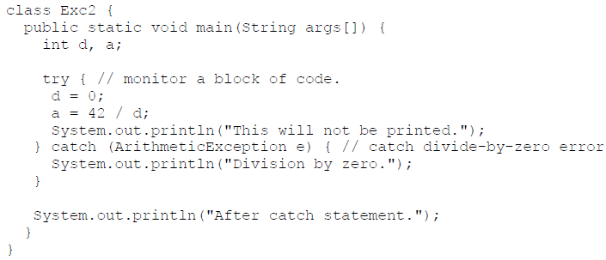
Example 1
This program generates the following output:
Division by zero.
After catch statement.

Slide 21
Example 1
Notice that the call to println( ) inside the try block is never executed. Once an exception is thrown, program control transfers out of the try block
Once the catch statement has executed, program control continues with the next line in the program following the entire try / catch mechanism. into the catch block.

Slide 22
A try and its catch statement form a unit. The scope of the catch clause is restricted to those statements specified by the immediately preceding try statement.
A catch statement cannot catch an exception thrown by another try statement.
The statements that are protected by try must be surrounded by curly braces.

Slide 23
Example 2
In this example, program each iteration of the for loop obtains two random integers. Those two integers are divided by each other, and the result is used to divide the value 12345.
The final result is put into a. If either division operation causes a divide-by-zero error, it is caught, the value of a is set to zero, and the program continues.

Slide 24
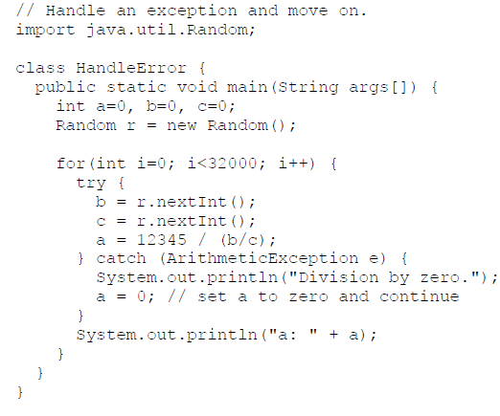
Example 2

Slide 25

Displaying a Description of an Exception
You can display this description in a println( ) statement by simply passing the exception as an argument.
For example, the catch block in the preceding program can be rewritten like this:
When the program is run, each divide by- zero error displays the following message:

Slide 26
Thank you

